Slide 1
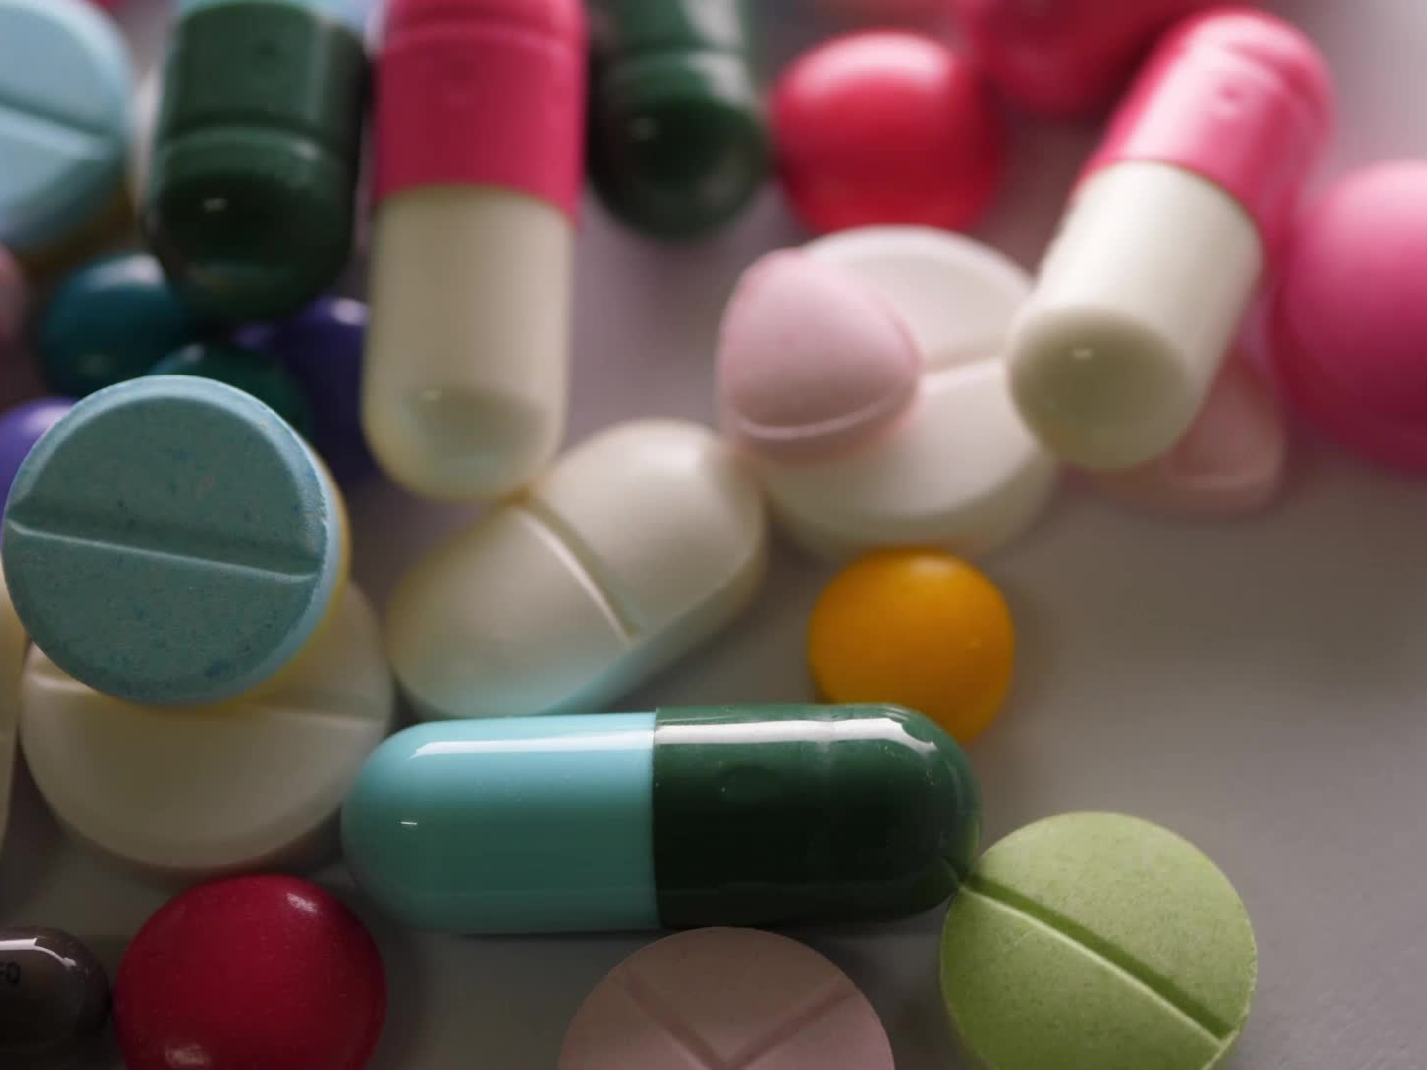
Drug Recommendation Chatbot

Slide 2

Introduction
AI-powered chatbot for drug recommendations
Goals: Recommend medications, check compatibility, assess age suitability
Scenarios:
1. Ask info about a drug
2. Request a recommendation for a disease

Slide 3
Dataset Description
CSV dataset from Kaggle, enhanced with AI
Columns: Drug Name, Medical Condition, Age Range, Interactions, Side Effects
Supports accurate, personalized responses

Slide 4
Technologies Used
Python – main development
Pandas – data processing
Regex – extract numeric age
CSV – structured data format
Streamlit – web interface
OpenAI ChatGPT – chat logic, user flow

Slide 5
Methodology
1. User enters age
2. Selects intent (info/recommendation/interaction)
3. Match input with dataset using string matching
4. Age compatibility check (green/red icons)
5. Drug interaction check
6. Generate response in natural language

Slide 6

Using GenAI
ChatGPT inspired input interpretation
Used for content generation and chat flow
Streamlit: Real-time GenAI interface
Result: A personalized GenAI-powered health assistant

Slide 7
Chatbot Conversation Flow
1. Greet user, ask age
2. Choose intent: Drug info / Condition-based
3. Show info: usage, age check, interactions, side effects
4. Interaction check (optional)
5. End with friendly message

Slide 8
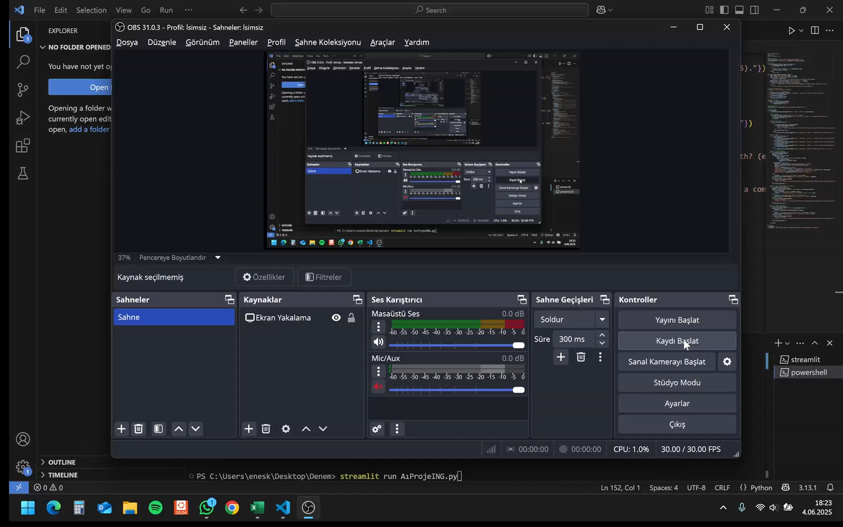
Project Video
Our Demo:

Slide 9
Conclusion
AI-powered prototype for safe drug use
Custom recommendations based on age, condition, drug use
Supports (but doesn't replace) doctors
Promotes digital health awareness

Slide 10

Thanks For Listening! ☺

